Slide 1
Team 5 Project Presentation

Slide 2
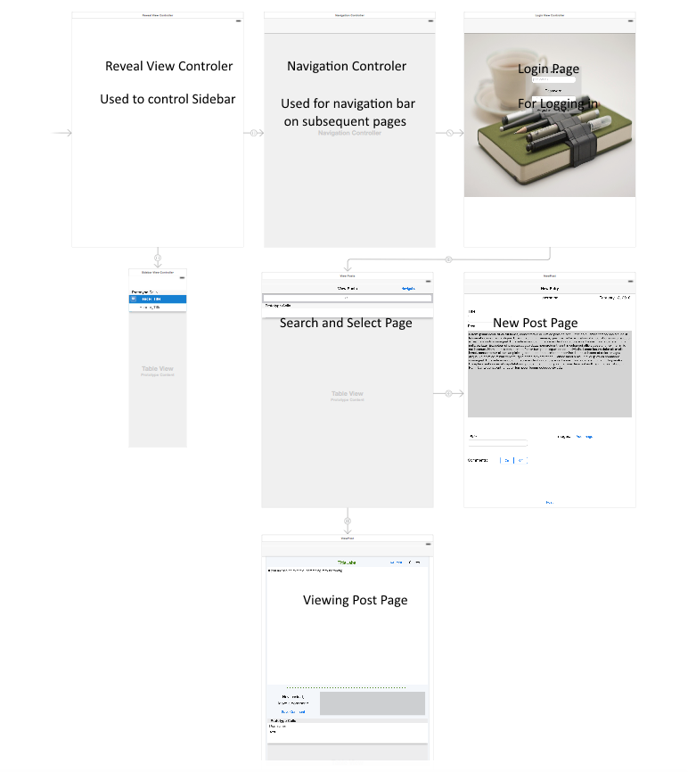
Software Design

Slide 3
Aspects of User Interface Design
Searching and viewing posts is all in one location. Immediately updates with search results
Tapping on the entry summary will view the entry for ease of use
Likes and comments are after you view the post, you cannot like or comment based on the summary
Trending will be shown on the journal view page upon selection from sidebar
Draggable scroll view to fit more search results
Title, content, and tags must have values before a new post can be made

